Slide 1



Amazon Product Bundling & Customer Recommendation
ISYE 7406 Project Group 115
Ashish Puri | Jagannath Banerjee | Piyush Shivrain
apuri61@gatech.edu | jbanerjee7@gatech.edu | pshivrain3@gatech.edu

Slide 2




Amazon Product Bundling and Recommendation
Objective
Title Goes Here
Conduct comprehensive analysis of Amazon sales trends and customer purchase behavior and build an application to determine association between the popular products, identify product bundles to improve cross-sell and recommend products to targeted customers.
Research Questions
Which products can be bundled together for up-sell and cross-sell ? (Slide – 11)
Which customer can be recommended for bundled products ? (Slide – 16)
Can we create customer segments for bulk recommendations ? (Slide – 13)
How much revenue increase is anticipated ? (Slide – 17)

Slide 3
Data
The Amazon sales dataset from Kaggle utilized for this effort. Data contains 3204 rows and 9 columns.
Attributes:
Column Name | Column Description
Order Date | Order Request Date
Ship Date | Shipping Date
Email ID | Email ID of Users
Geography | Location of Orders by Users
Category | Product Category
Product Name | Product Name of Amazon
Sales | Amazon Product Sales
Quantity | How many units of a particular product are available
Profit | Amazon Sales Profit
Credit : Amazon_Sales_Dataset (kaggle.com)

Slide 4
Exploratory Data Analysis

Slide 5
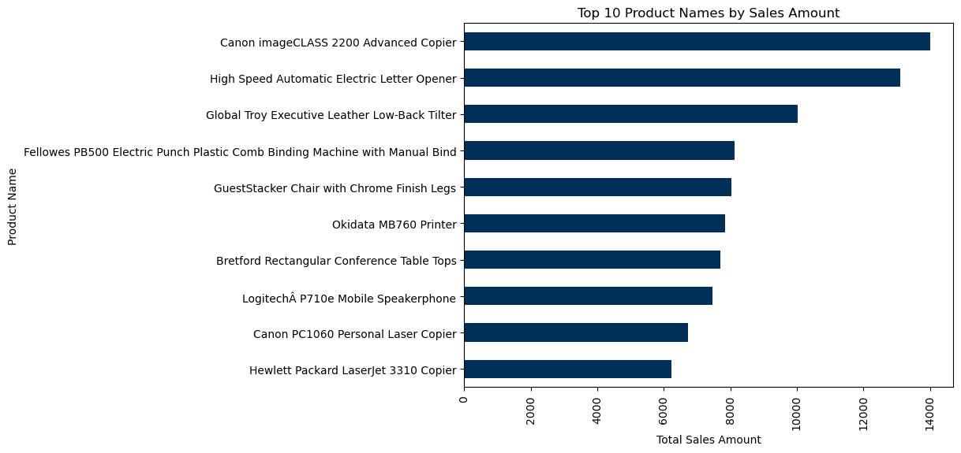
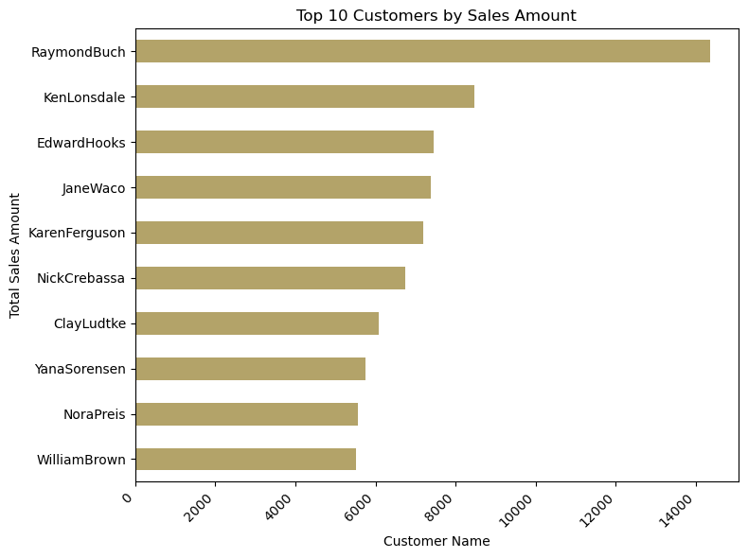
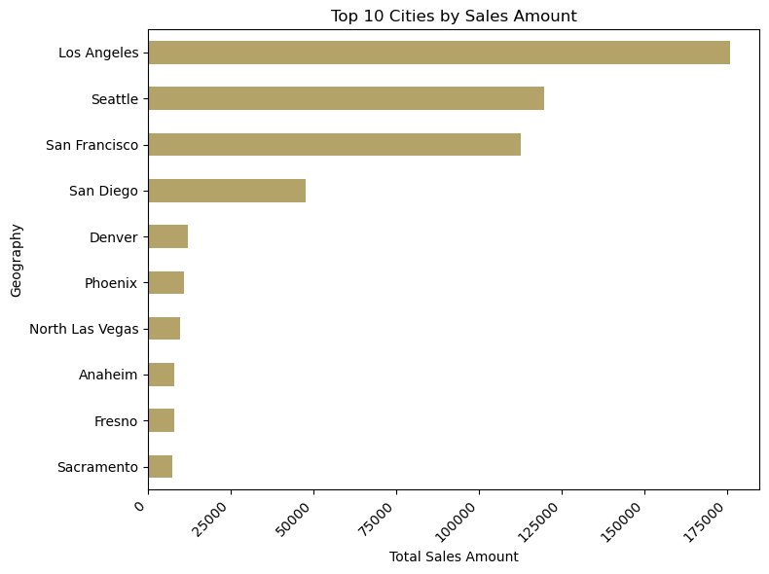
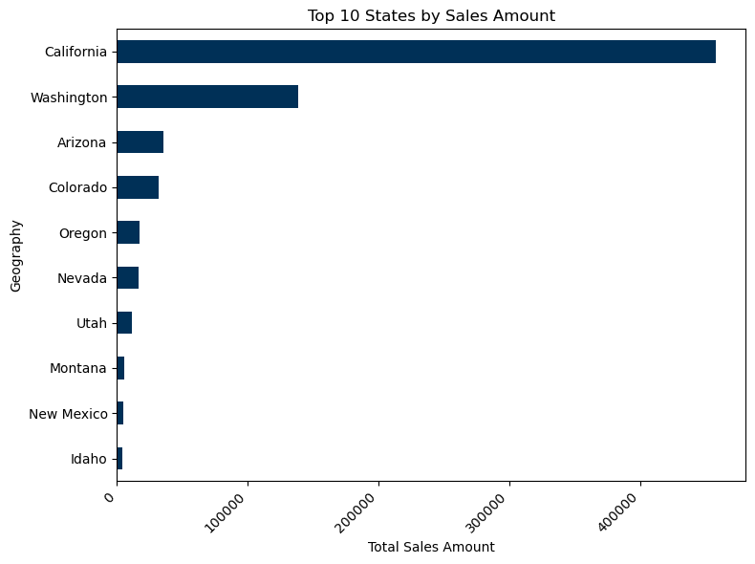
Top Products, Customer & Geography by Sales
Title Goes Here

Slide 6
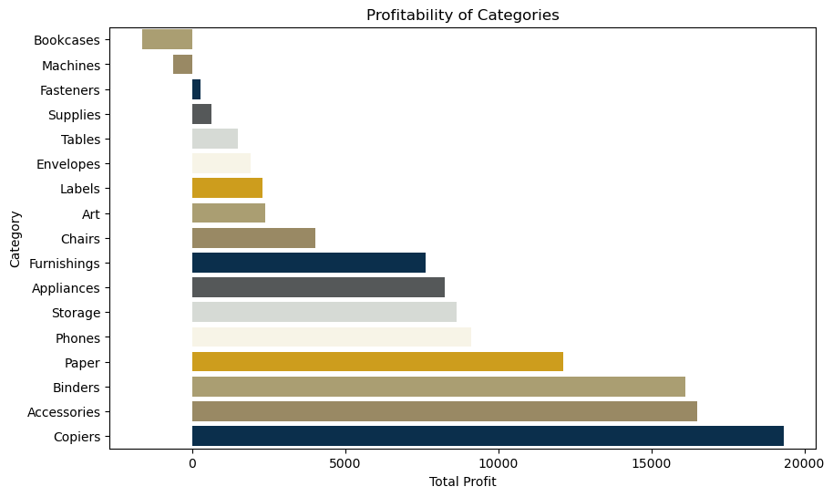
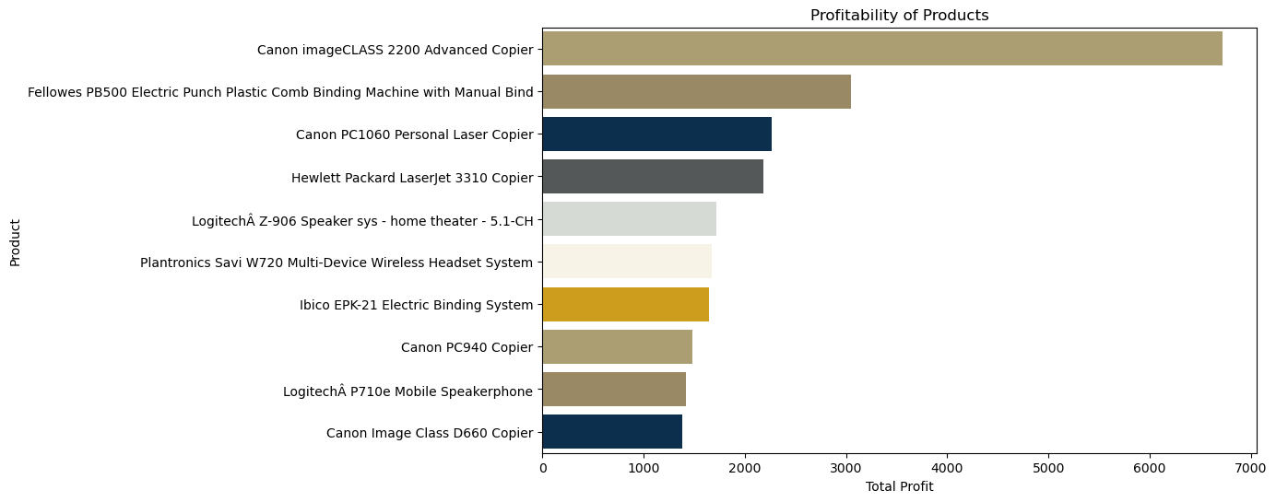
Profitable Products & Categories
Title Goes Here
Copiers is most profitable while bookcases seems the least
Cannon Image Class 2200 is most profitable

Slide 7
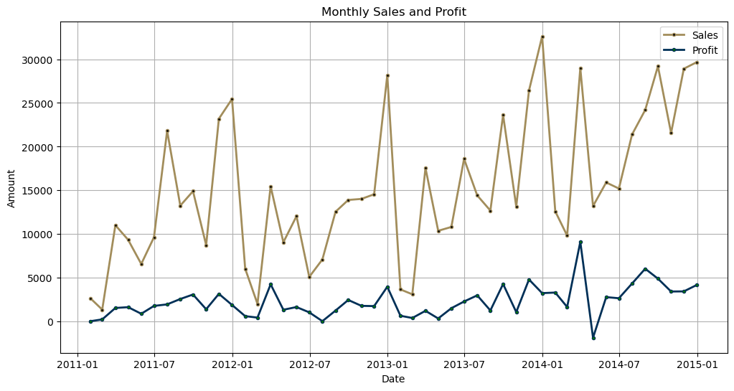
Profit & Sales Trend
Both Profit & Sales have increasing trend Year over Year from 2011 to 2014
Sales & Profit peaked during Dec every year
Seasonality effects are evident overall
Title Goes Here

Slide 8
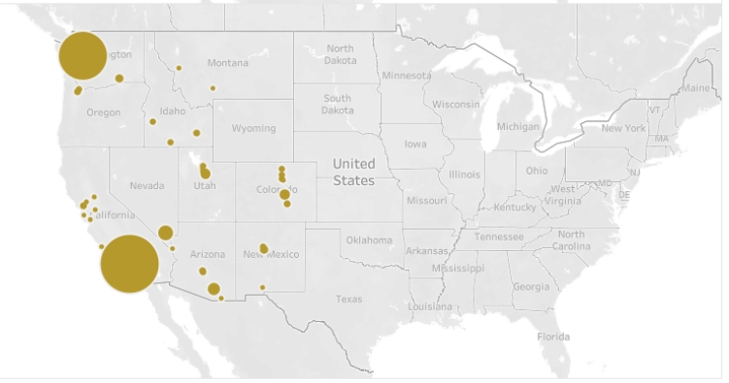
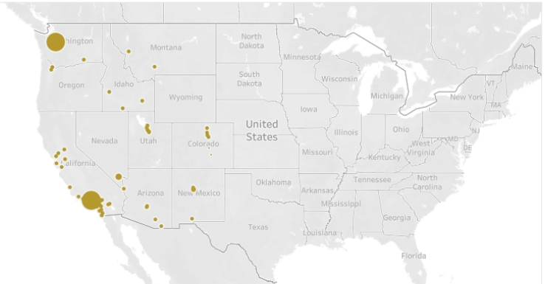
Sales & Profit by Geography
Title Goes Here
Sales
Most Profit & Sales came from California and Washington
No Sales in Midwest or East coast during 2011-2014
Profit

Slide 9
Modelling & Results

Slide 10
Product Association/Grouping
We converted the sales data at order and product level to create a list of all receipts over 2011 to 2014.
We used association rule mining to determine the association between the products sold. An association rule is an implication expression of the form X->Y , where X & Y are disjoint item sets.
Association Rule Mining has 3 important aspects. Given a rule "A -> C", A stands for antecedent, and C stands for consequent.
Support : Support measures the frequency or the proportion of transactions in the dataset in which a particular combination of items (or itemset) appears together.
support(A→C)=support(A∪C),range: [0,1]
Confidence : The confidence of a rule A->C is the probability of seeing the consequent in a transaction given that it also contains the antecedent.
confidence(A→C)=support(A→C)/support(A),range: [0,1]
Lift : The lift metric is commonly used to measure how much more often the antecedent and consequent of a rule A->C occur together than we would expect if they were statistically independent. If A and C are independent, the Lift score will be exactly 1.
lift(A→C)=confidence(A→C)/support(C),range: [0,∞]
4. Using the above logic, we extracted the products with strongest associations i.e. Lift > 1.2 and confidence >=0.65
Title Goes Here

Slide 11
Results - Product Association/Grouping
Which products are associated and can be bundled together for up-sell and cross-sell ?
Focus Product | Associated Product | Lift | Confidence | Support
O'Sullivan 4-Shelf Bookcase in Odessa Pine | GBC Standard Recycled Report Covers, Clear Plastic Sheets | 201 | 50% | 0.12%
GBC Standard Recycled Report Covers, Clear Plastic Sheets | O'Sullivan 4-Shelf Bookcase in Odessa Pine | 201 | 50% | 0.12%
Tennsco Regal Shelving Units | Staples | 14 | 50% | 0.12%
GBC Wire Binding Combs | Carina Double Wide Media Storage Towers in Natural & Black | 179 | 67% | 0.12%
Wirebound Four 2-3/4 x 5 Forms per Page, 400 Sets per Book | Staples | 14 | 50% | 0.12%
#10 White Business Envelopes,4 1/8 x 9 1/2 | Staples | 28 | 100% | 0.12%
Advantus Rolling Storage Box | Great White Multi-Use Recycled Paper (20Lb. and 84 Bright) | 215 | 67% | 0.12%
Xerox 1894 | Xerox 225 | 115 | 50% | 0.12%
Boston 16765 Mini Stand Up Battery Pencil Sharpener | Microsoft Natural Ergonomic Keyboard 4000 | 537 | 100% | 0.12%
Microsoft Natural Ergonomic Keyboard 4000 | Boston 16765 Mini Stand Up Battery Pencil Sharpener | 537 | 67% | 0.12%
* Our criteria for strong Association is at Least 60% confidence in association and life greater than 1.2

Slide 12
Customer Grouping
This is a customer level information. We grouped customer to calculate the Recency, Frequency and Monetary Value over 2011-2014
Recency (R) refers to how recently a customer has made a purchase or engaged with the business.
R_i = (Max_Date – Purchase_Date)
Frequency (F) measures how often a customer makes purchases or interacts with the business over a specific period.
F_i = count of all transaction for the customer
Monetary (M) value represents the total amount of money spent by a customer over a certain period.
M-I = sum of Sales $ for the customer.
We calculated relative recency, frequency and monetary values by create a quartile of 1 to 5 for each of them.
3. We summed relative recency, frequency and monetary values quartile scores to have a customer score and ranked the customer in ascending order to get the most valued customers for targeted marketing.
Title Goes Here
Recency | Frequency | Monetary
R-Tier-1 (most recent) | F-Tier-1 (most frequent) | M-Tier-1 (highest spend)
R-Tier-2 | F-Tier-2 | M-Tier-2
R-Tier-3 | F-Tier-3 | M-Tier-3
R-Tier-4 | F-Tier-4 | M-Tier-4
R-Tier-5 (least recent) | F-Tier-5 (only one transaction) | M-Tier-5 (lowest spend)

Slide 13
Results - Customer Grouping
Can we create customer segments for bulk recommendations ?
Customer Name | Recency | Frequency | TotalSpend | Rel_Frequency | Rel_TotalSpend | Rel_Recency | Rqm_Score | Rank | Segment
LaurelBeltran | 250 | 14 | 2836.04 | 4 | 5 | 5 | 14 | 1 | 2
SandraGlassco | 46 | 10 | 2567.151 | 3 | 5 | 5 | 13 | 2 | 0
AlanDominguez | 98 | 5 | 4353.34 | 2 | 5 | 5 | 12 | 3 | 0
AlanSchoenberger | 371 | 9 | 2017.184 | 3 | 5 | 4 | 12 | 4 | 0
ArthurGainer | 523 | 9 | 2382.179 | 3 | 5 | 4 | 12 | 5 | 0
... | ... | ... | ... | ... | ... | ... | ... | ... | ...
MauriceSatty | 965 | 4 | 83.102 | 1 | 1 | 2 | 4 | 682 | 1
BenjaminPatterson | 1312 | 3 | 145.66 | 1 | 1 | 1 | 3 | 683 | 1
ChristineKargatis | 1188 | 3 | 140.708 | 1 | 1 | 1 | 3 | 684 | 1
PatrickJones | 1274 | 4 | 137.504 | 1 | 1 | 1 | 3 | 685 | 1
PaulLucas | 1141 | 3 | 88.57 | 1 | 1 | 1 | 3 | 686 | 1
Customers are ranked and placed in appropriate segment for recommendation

Slide 14
Results - Customer Grouping
Similar Customers were clustered using K-Mean clustering in 5 groups using Recency, Frequency and Monetary value. Below are the cluster summary:
Segment | Recency (days) | Frequency | Total Spend ($) | Insights | Marketing Strategy
0 | 370.69 | 6.27 | 2039.29 | Recent purchasers with high total spend. Likely regular customers contributing significantly to revenue and profit. | Maintain loyalty with personalized recommendations, special discounts, and targeted marketing campaigns.
1 | 853.85 | 4.5 | 682.61 | Moderate engagement and expenditure but haven't made recent purchases. | Re-engage with personalized reminders, limited-time discounts, and showcasing new products.
2 | 963.9 | 10.32 | 1682.67 | High frequency of transactions but haven't made recent purchases. Moderate expenditure. | Reactivate with targeted campaigns, personalized messages, and referral incentives.
3 | 63.35 | 2.08 | 365.14 | Recent shoppers with moderate engagement and expenditure. Likely new or occasional shoppers. | Implement first-time buyer programs, welcome discounts, and recommend popular products to increase purchase frequency and amount.
4 | 874.46 | 9.23 | 5620.29 | Loyal customers with recent purchases, high engagement, and expenditure. | Strengthen loyalty with exclusive rewards, early access, and feedback programs.

Slide 15
Customer Recommendation
For Customer Recommendation, we have used Content-based filtering method as our recommender engine. Content-based filtering uses item features to recommend other items similar to what the user likes, based on their previous actions or explicit feedback.
We built user profile using Clustering of customers and their buying pattern.
We used association rule to understand the product association
Based on the association and customer buying pattern, we recommended product to customer.
We rank the customers with highest probability using R, F & M Quantile score.
Title Goes Here
Sales Order
Product Association
Recommendations
Recommender System
Rank Recommendations
Customer Clusters
Geography

Slide 16
Results - Customer Recommendations
Which customer can be recommended for bundled products ?
Customer | Product Recommendation | Recommendation Comments
JustinRitter | GBC Standard Recycled Report Covers, Clear Plastic Sheets | Customer bought product O'Sullivan 4-Shelf Bookcase in Odessa Pine and not GBC Standard Recycled Report Covers, Clear Plastic Sheets.
KeithHerrera | GBC Standard Recycled Report Covers, Clear Plastic Sheets | Customer bought product O'Sullivan 4-Shelf Bookcase in Odessa Pine and not GBC Standard Recycled Report Covers, Clear Plastic Sheets.
MarkHaberlin | O'Sullivan 4-Shelf Bookcase in Odessa Pine | Customer bought product GBC Standard Recycled Report Covers, Clear Plastic Sheets and not O'Sullivan 4-Shelf Bookcase in Odessa Pine.
PatrickGardner | O'Sullivan 4-Shelf Bookcase in Odessa Pine | Customer bought product GBC Standard Recycled Report Covers, Clear Plastic Sheets and not O'Sullivan 4-Shelf Bookcase in Odessa Pine.
FredMcMath | Staples | Customer bought product Tennsco Regal Shelving Units and not Staples.
ScottWilliamson | Staples | Customer bought product Tennsco Regal Shelving Units and not Staples.
AlanBarnes | Carina Double Wide Media Storage Towers in Natural & Black | Customer bought product GBC Wire Binding Combs and not Carina Double Wide Media Storage Towers in Natural & Black.
ChadSievert | Staples | Customer bought product Wirebound Four 2-3/4 x 5 Forms per Page, 400 Sets per Book and not Staples.
PenelopeSewall | Staples | Customer bought product Wirebound Four 2-3/4 x 5 Forms per Page, 400 Sets per Book and not Staples.
CynthiaDelaney | Great White Multi-Use Recycled Paper (20Lb. and 84 Bright) | Customer bought product Advantus Rolling Storage Box and not Great White Multi-Use Recycled Paper (20Lb. and 84 Bright).
DennyJoy | Xerox 225 | Customer bought product Xerox 1894 and not Xerox 225.
JohnLucas | Xerox 225 | Customer bought product Xerox 1894 and not Xerox 225.
KalycaMeade | Boston 16765 Mini Stand Up Battery Pencil Sharpener | Customer bought product Microsoft Natural Ergonomic Keyboard 4000 and not Boston 16765 Mini Stand Up Battery Pencil Sharpener.

Slide 17
Business Benefit
How much revenue opportunity is anticipated ?
Customer | Product Recommendation | Unit Price ($) | Average Purchase/Year | Opportunity ($)
JustinRitter | GBC Standard Recycled Report Covers, Clear Plastic Sheets | $ 3.24 | 10 | $ 32.40
KeithHerrera | GBC Standard Recycled Report Covers, Clear Plastic Sheets | $ 3.24 | 10 | $ 32.40
MarkHaberlin | O'Sullivan 4-Shelf Bookcase in Odessa Pine | $ 102.00 | 5 | $ 510.00
PatrickGardner | O'Sullivan 4-Shelf Bookcase in Odessa Pine | $ 102.00 | 5 | $ 510.00
FredMcMath | Staples | $ 28.40 | 5 | $ 142.00
ScottWilliamson | Staples | $ 28.40 | 5 | $ 142.00
AlanBarnes | Carina Double Wide Media Storage Towers in Natural & Black | $ 80.98 | 6 | $ 485.88
ChadSievert | Staples | $ 28.40 | 10 | $ 284.00
PenelopeSewall | Staples | $ 28.40 | 10 | $ 284.00
CynthiaDelaney | Great White Multi-Use Recycled Paper (20Lb. and 84 Bright) | $ 5.98 | 100 | $ 598.00
DennyJoy | Xerox 225 | $ 20.74 | 6 | $ 124.44
JohnLucas | Xerox 225 | $ 20.74 | 6 | $ 124.44
KalycaMeade | Boston 16765 Mini Stand Up Battery Pencil Sharpener | $ 11.66 | 20 | $ 233.20
Total Opportunity |  |  |  | $ 3,502.76
Considerations:
Top10 customer product combination is considered
Average Purchase/Year is calculated by taking average qty sold over 2011-2014
Unit Price is calculated dividing Sales Price/Qty
Opportunity ($) = Unit Price * Average Purchase/Year

Slide 18
Conclusion
We considered the Amazon sales dataset from Kaggle contains sales data from 2011-2014.
With the Sales data we found there are several product being sold together and have strong associations like Wirebound Four 2-3/4 x 5 Forms per Page, 400 Sets per Book & Staples, Xerox 1894 & Xerox 225,m #10 White Business Envelopes,4 1/8 x 9 ½ & Staples. (Slide-11)
We segmented customers based on Recency, Frequency and Monetary value and observed a possibility of 5 grouping – Recent purchase & High spend, Moderate engagement & spend, High frequency & moderate expenditure, Recent with moderate expenditure and Recent Purchase with high frequency customer. We created targeted selling strategy for these customers .(Slide 14)
Using the product and customer combination, we created targeted recommendations for customers.
Finally, we calculated the up-sell and cross-sell revenue opportunity with our marketing effort and realize a potential gain of $3,500 from top 10 customer with only few combinations.

Slide 19
Future Work
We can consider can larger data set to identify more profitable combinations.
We can build an application for recommendation and receive customer feedback to improve the recommendation.
Try out collaborative filtering methodology for improving recommendations.

Slide 20
References
https://www.upwork.com/resources/what-is-content-based-filtering
https://developers.google.com/machine-learning/recommendation/content-based/basics
https://en.wikipedia.org/wiki/Recommender_system
https://rasbt.github.io/mlxtend/
https://www.turing.com/kb/content-based-filtering-in-recommender-systems

